Slide 1
Predicting Housing Sales Prices in Ames, Iowa
Balineni Priyanka
Hanus Andrew
Waingankar Varsha

Slide 2
Presentation Overview
Problem Statement
Dataset Overview
Strategy Explained
Analysis and Findings
Best Model Identified
Conclusion

Slide 3
Problem Statement
Can housing sales prices be accurately predicted using disparate but relevant data?
Can we identify a prediction model that would be most helpful in addressing this problem?
Can we achieve a Sales Price prediction value that is >85% accurate?

Slide 4
Business Case
The 2006 sudden and immense downturn in U.S. House Prices sparked the 2007 global financial crisis and revived the interest about forecasting such imminent threats for economic stability
Housing prices adjustments play an important role in the determination of the phase of the business cycle.
When the economy booms, construction and employment in the housing sector expand rapidly to respond to excess demand, rapidly pushing nominal house prices upwards. During the contraction phase, the drop in private income reduces aggregate demand and nominal house prices

Slide 5
Purpose & Goal
Ask a home buyer to describe their dream house, and they probably won't begin with the height of the basement ceiling or the proximity to an Airport. But this dataset proves that many more parameters influences price negotiations than the number of bedrooms or a white-picket fence.
With 79 explanatory variables describing (almost) every aspect of residential homes in Ames, Iowa, the goal is to predict the final price of each home with a reasonable level of accuracy.

Slide 6
Dataset Overview
Column Definitions
Dataset Values
Dataset as data.frame in R

Slide 7
Column Definitions
MSSubClass: Identifies the type of dwelling involved in the sale.
MSZoning: Identifies the general zoning classification of the sale.
LotFrontage: Linear feet of street connected to property
LotArea: Lot size in square feet
Street: Type of road access to property
Alley: Type of alley access to property
LotShape: General shape of property
LandContour: Flatness of the property
Utilities: Type of utilities available
LotConfig: Lot configuration

Slide 8
Column Definitions (cont)
LandSlope: Slope of property
Neighborhood: Physical locations within Ames city limits
Condition1: Proximity to various conditions
BldgType: Type of dwelling
HouseStyle: Style of dwelling
OverallQual: Rates the overall material and finish of the house
OverallCond: Rates the overall condition of the house
Heating: Type of heating

Slide 9
Column Definitions (cont)
TotalBsmtSF: Total square feet of basement area
1stFlrSF: First Floor square feet
2ndFlrSF: Second floor square feet
GarageArea: Size of garage in square feet
WoodDeckSF: Wood deck area in square feet
YearBuilt: Original construction date
YearRemodAdd: Remodel date (same as construction date if no remodeling or additions)

Slide 10
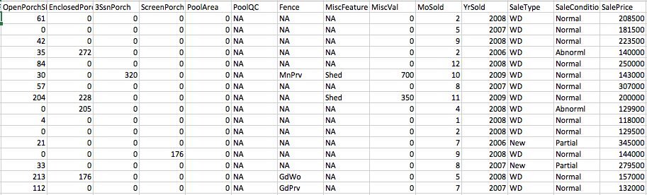
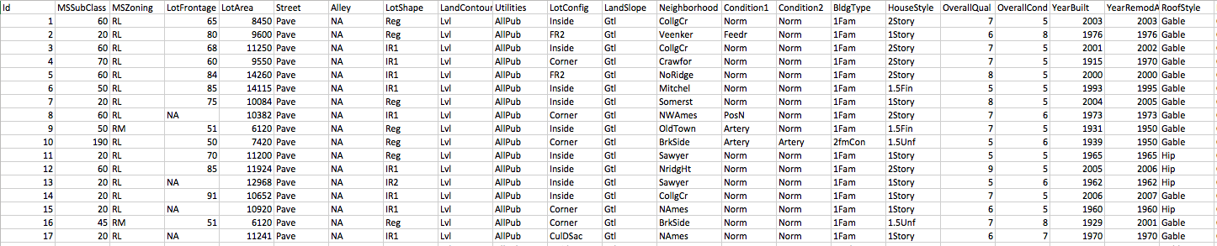
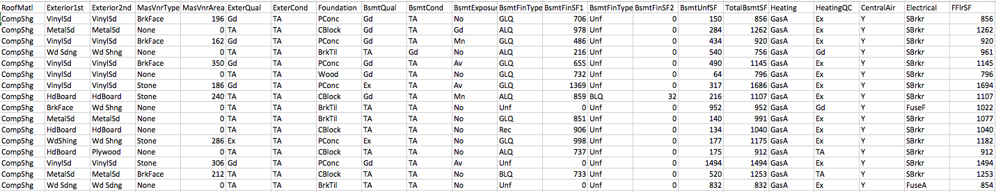
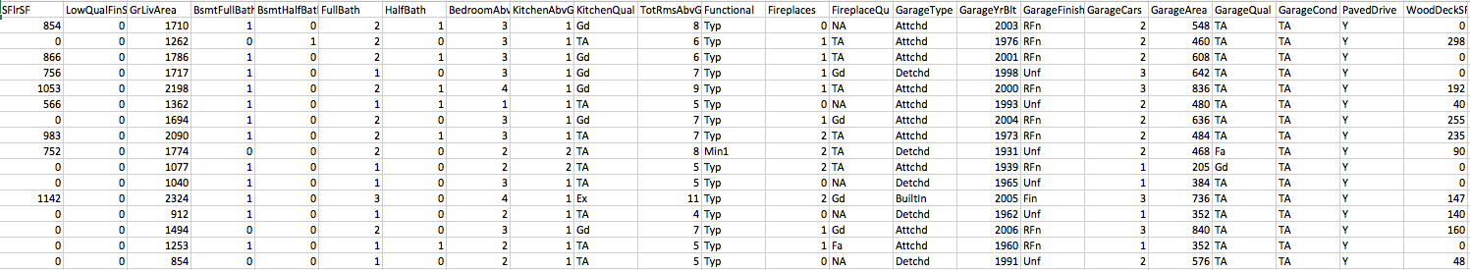
Dataset Values

Slide 11
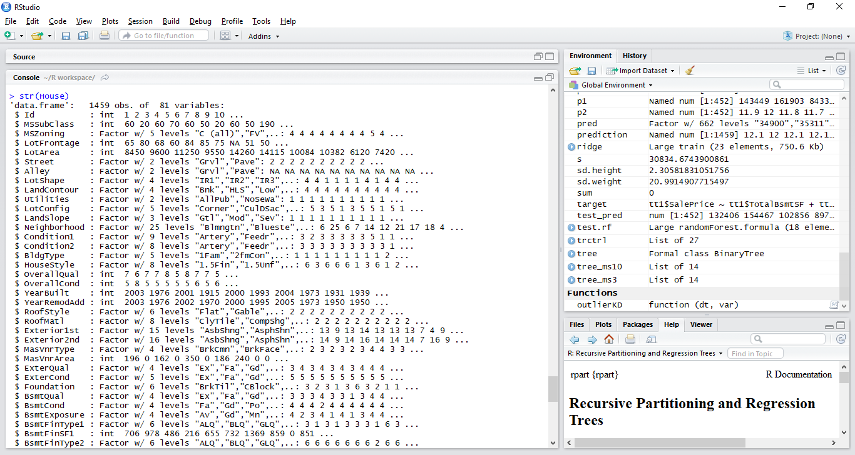
R Breakdown of Dataset as data.frame

Slide 12
Visualizations of Dataset
Distribution of key variable.
Average values of key variable based on key correlations.
Mean values of key variable
Highlighting some key trends associated with key variable
Decision Tree
Visualization of Strongest Single factor correlations
Visualization of Strongest Multivariate correlations

Slide 13
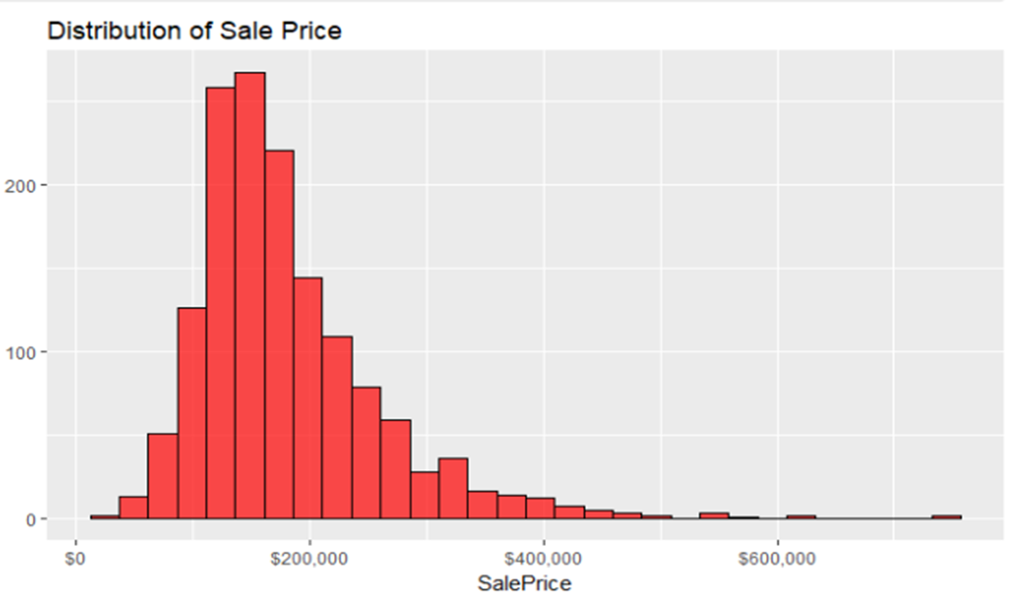

Slide 14
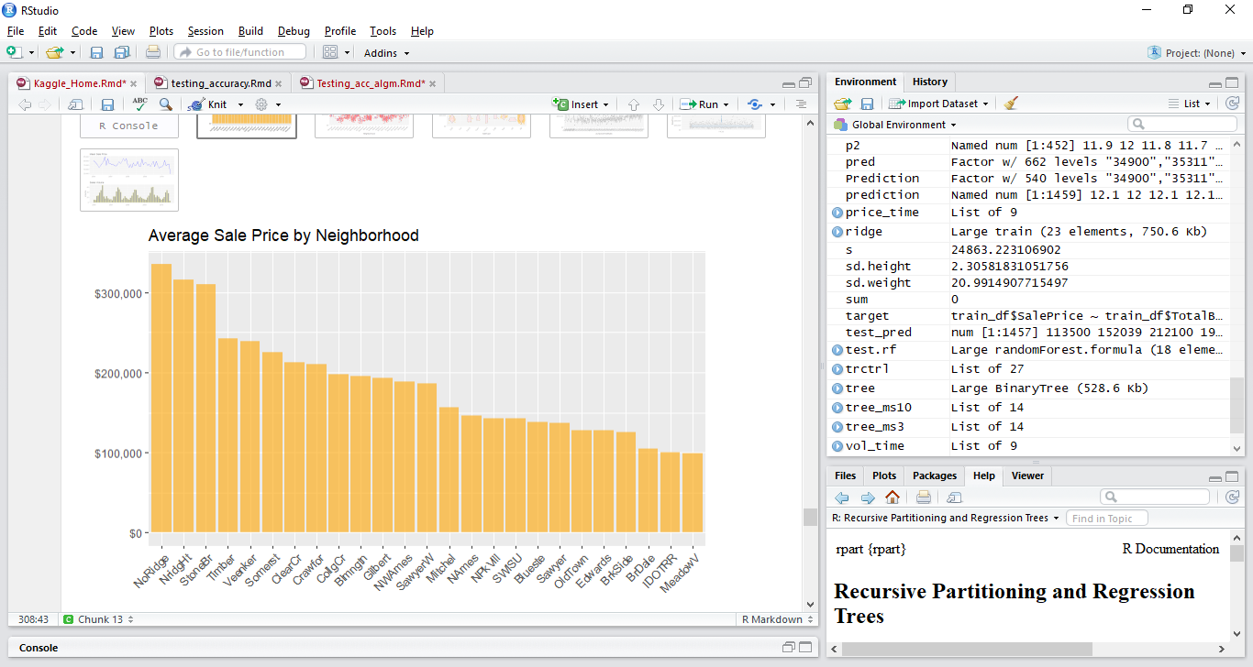

Slide 15
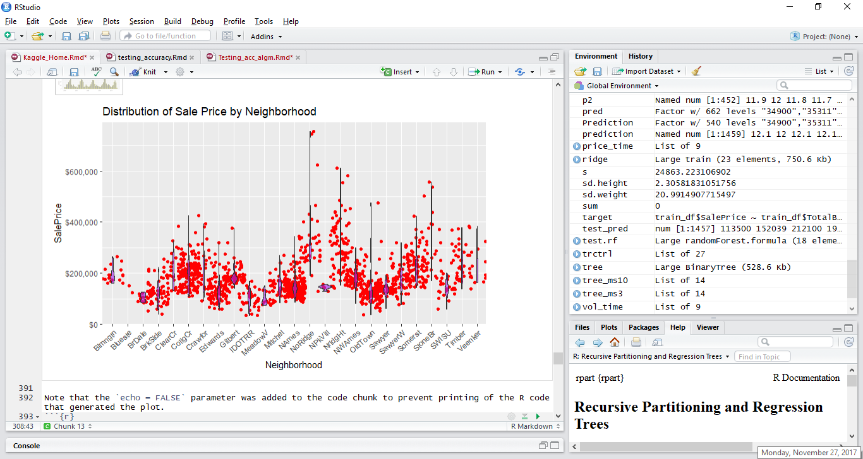

Slide 16
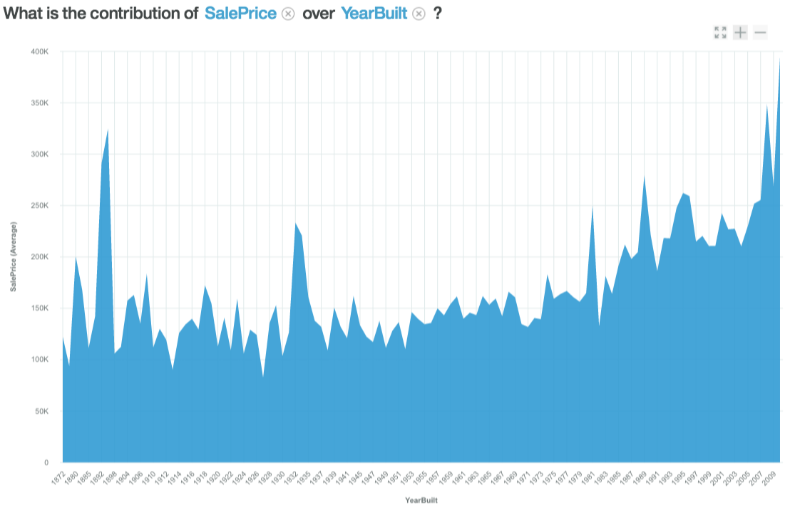

Slide 17
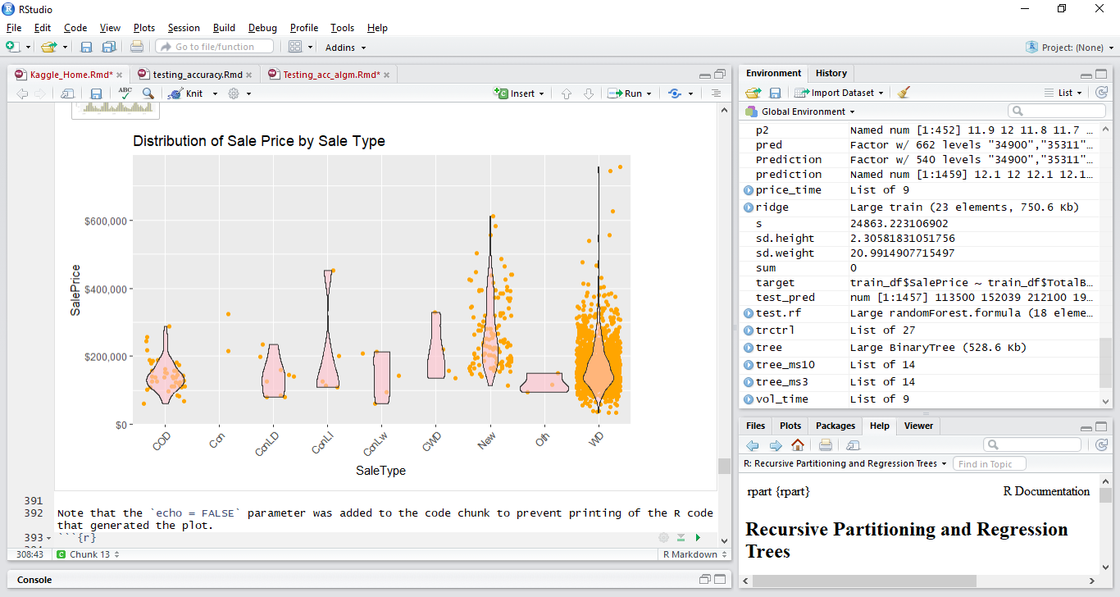

Slide 18
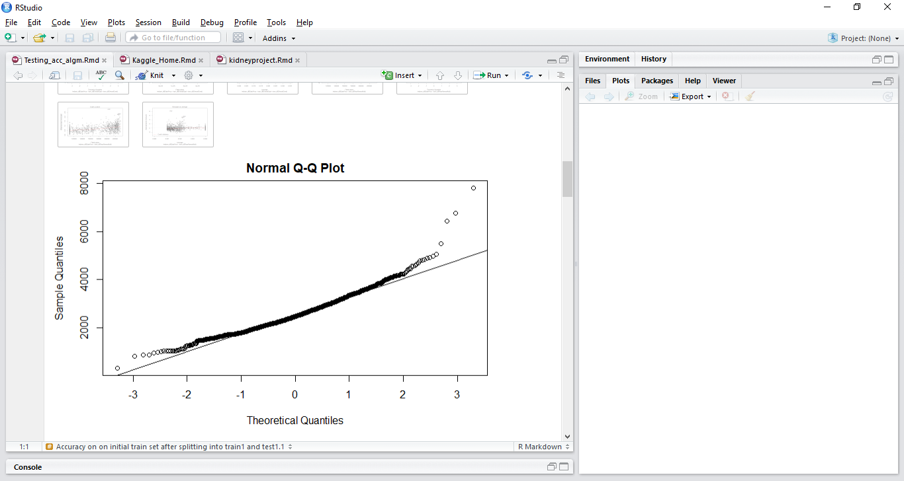
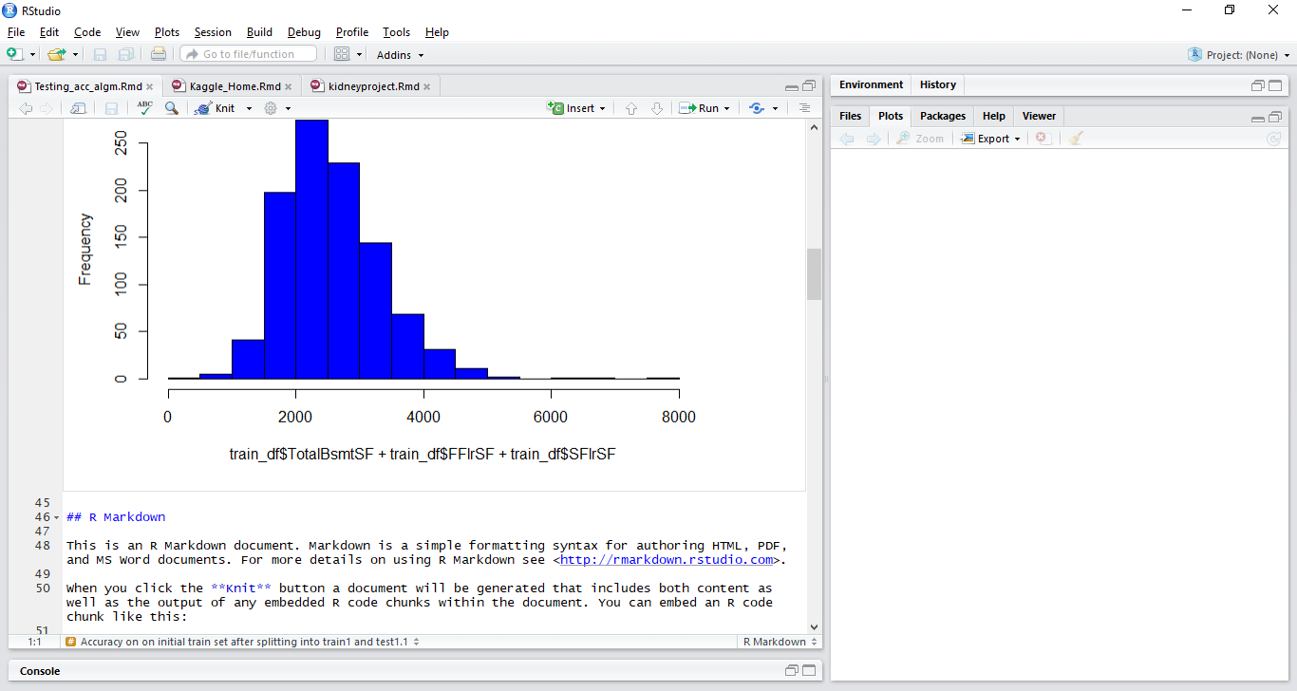
Histogram of Square Footage

Slide 19
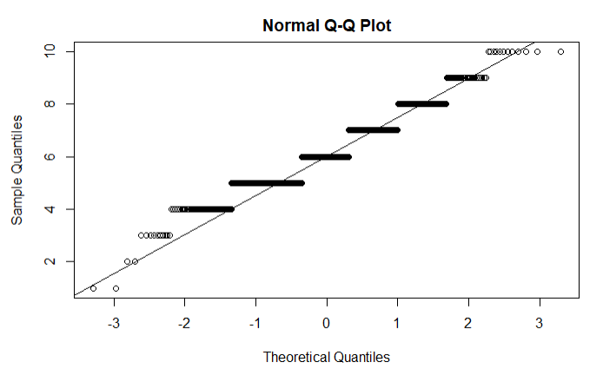
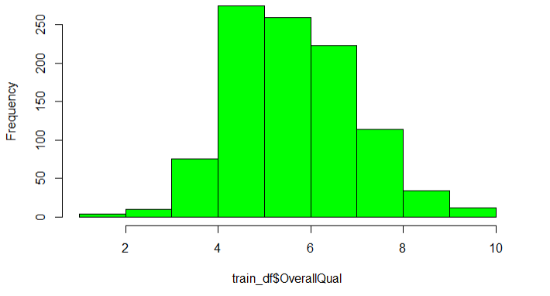
Histogram of Overall Quality

Slide 20
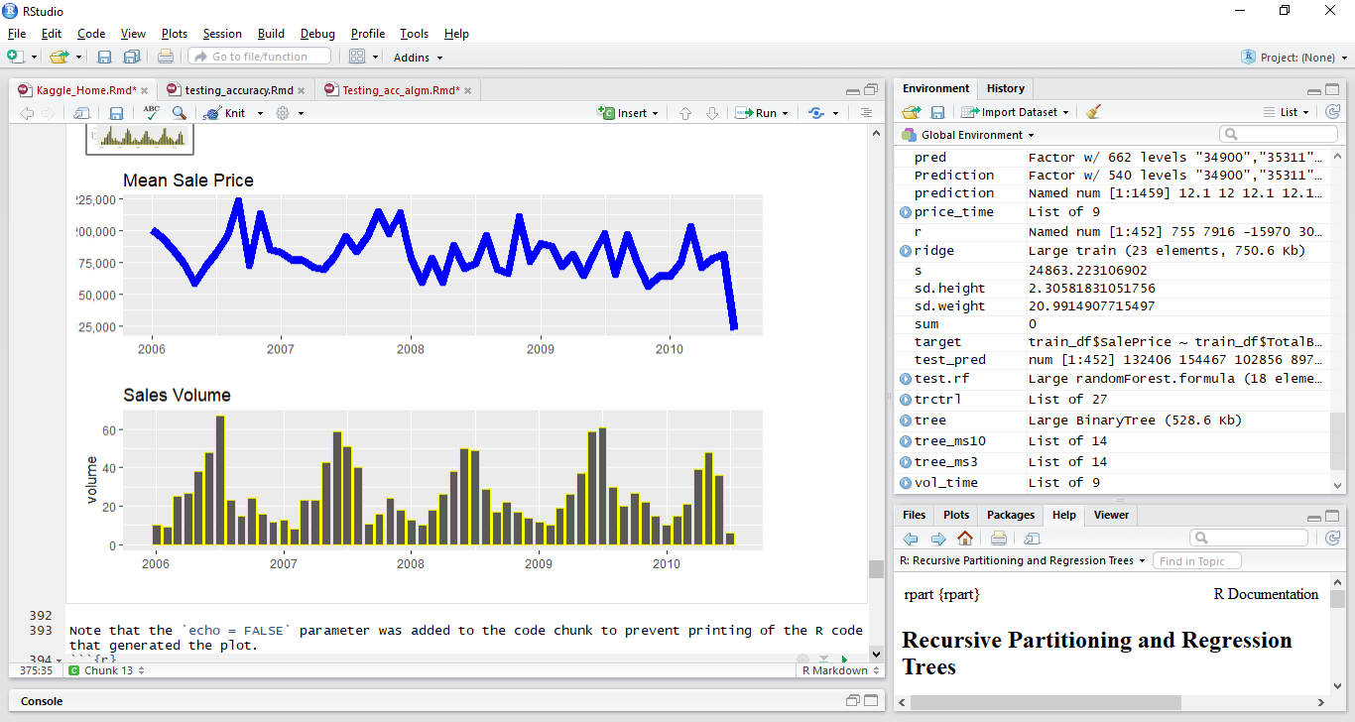

Slide 21
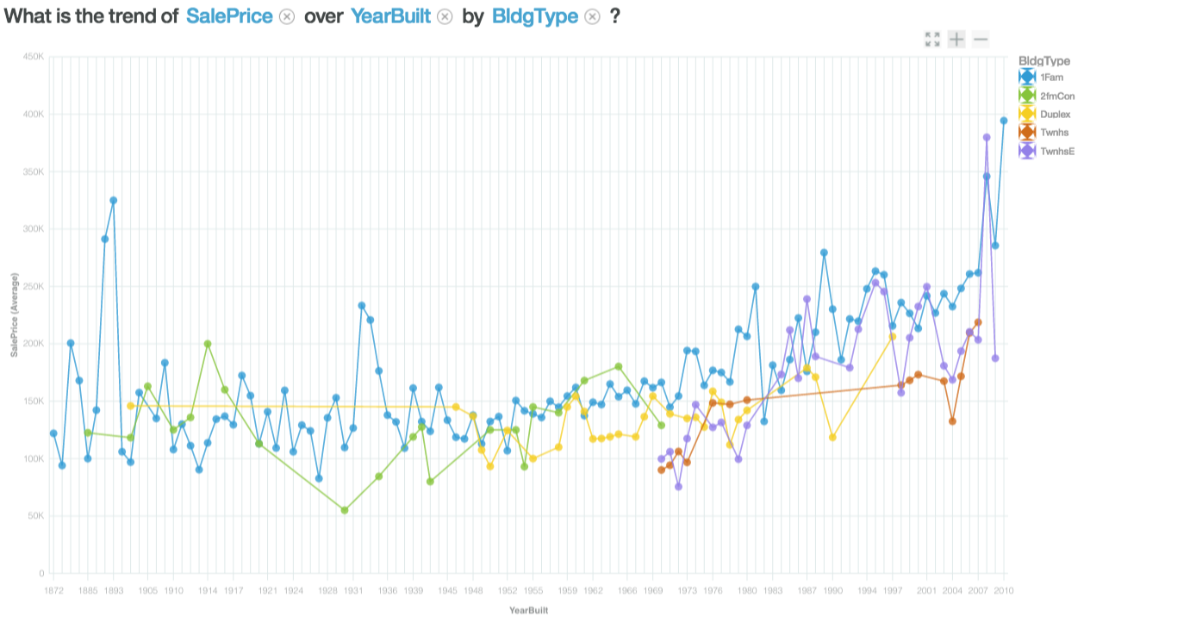

Slide 22
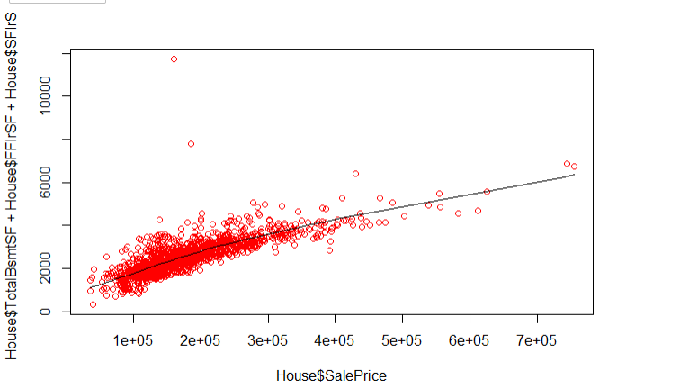
Correlation between Square footage and sale price 0.7822

Slide 23
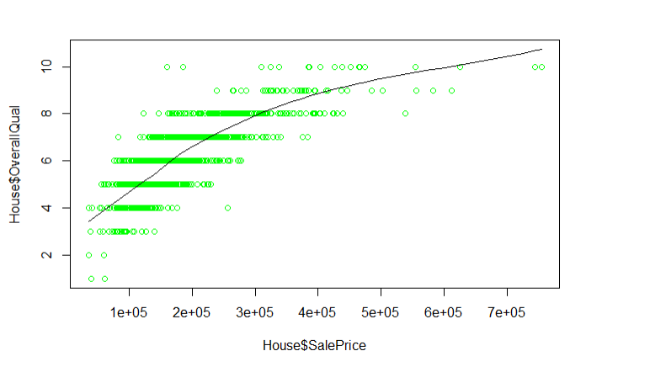
Correlation between sale price and overall quality 0.79

Slide 24
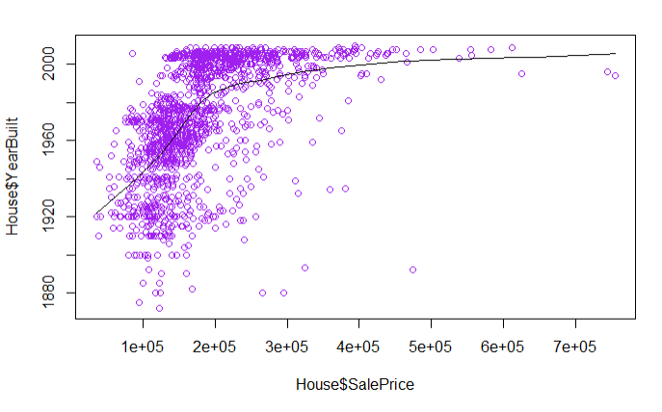
Correlation between sale price and year built 0.52287

Slide 25
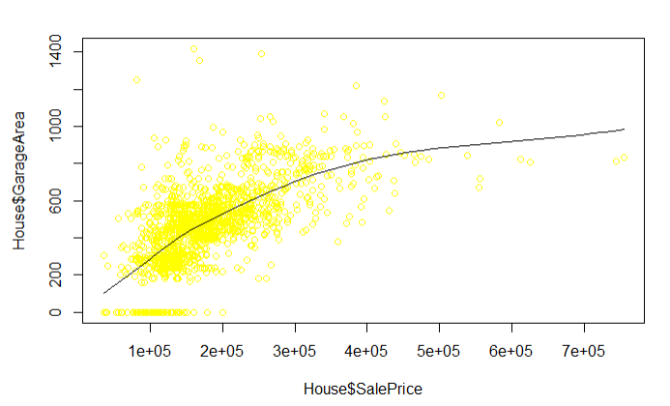
Correlation between sale price and garage Area is 0.623

Slide 26
Statistical Analysis
SalePrice
Zscore - 1.959964
Upper Limit - 190228.70
First Floor Sq Ft
Zscore - 1.959964
Second Floor
Zscore - 1.959964
Basement Sq Footage
Confidence Interval - 97.5%
# of observations - 1459
Standard Error - 9284.636
Lower Limit - 171659.50
Confidence Interval - 97.5%
# of observations - 1459
Standard Error – 19.84306
Lower Limit - 1142.72
Upper Limit - 1182.406
Confidence Interval - 97.5%
# of observations - 1459
Standard Error - 22.40205
Lower Limit - 324.8282
Upper Limit - 369.6323
Zscore - 1.9599
Confidence Interval - 97.5%
# of observations - 1459
Standard Error - 22. 51706
Lower Limit - 1034.776
Upper Limit - 1079.81
Mean sale price training set is 194597.8
Mean sale price test set is 177510.6

Slide 27
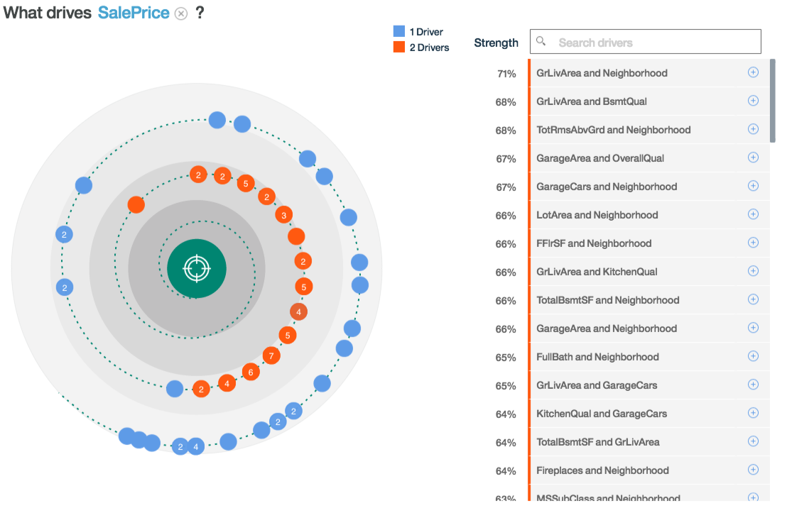

Slide 28
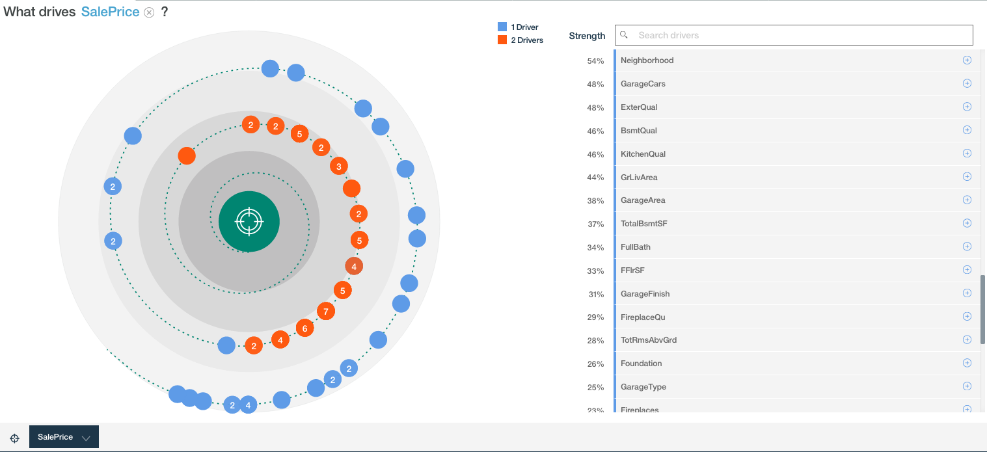

Slide 29
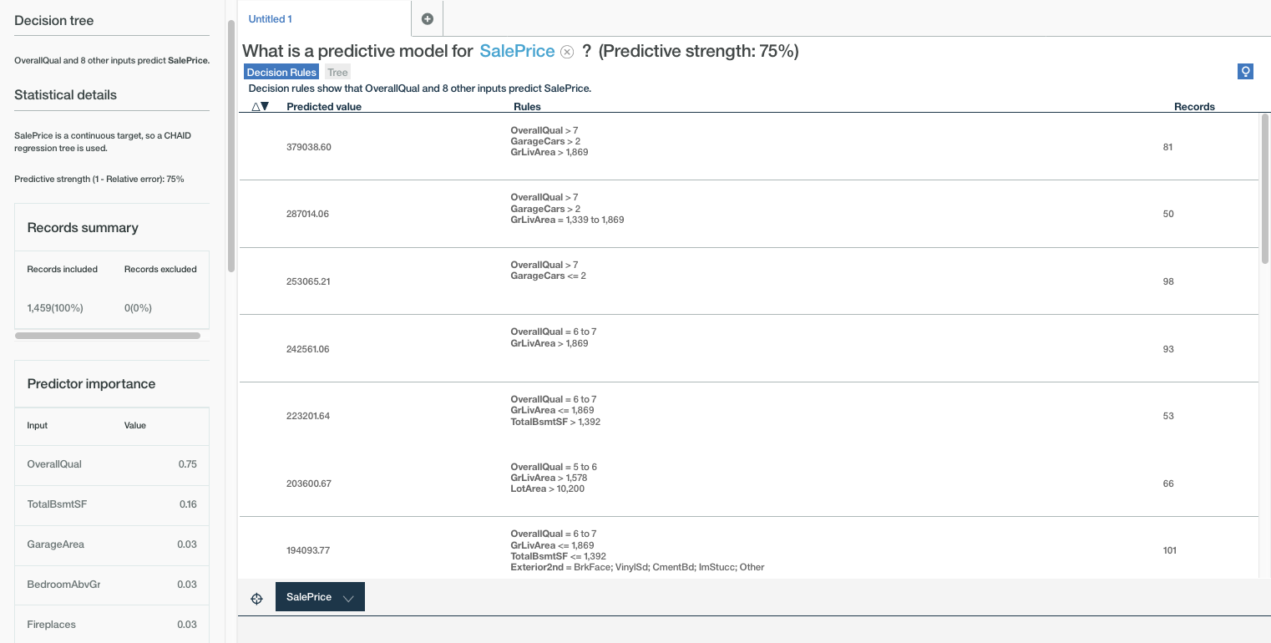
Decision Tree – Showing Predictive model for SalePrice (1/3)

Slide 30
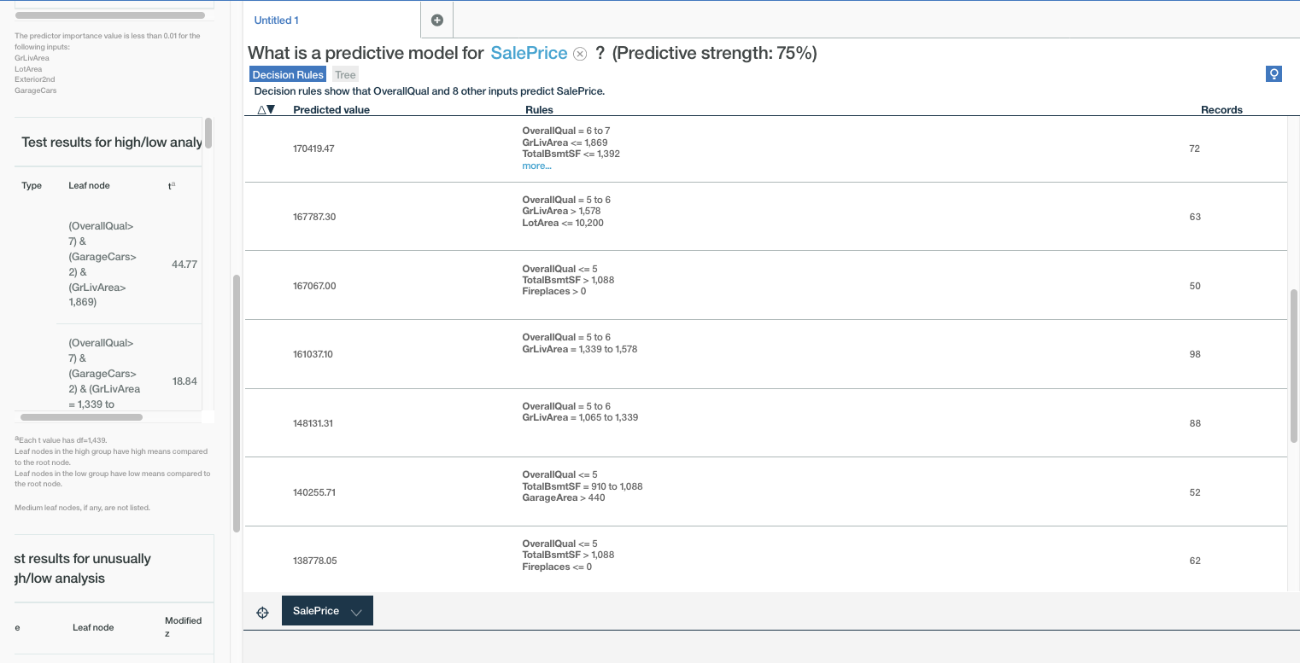
Decision Tree – Showing Predictive model for SalePrice (2/3)

Slide 31
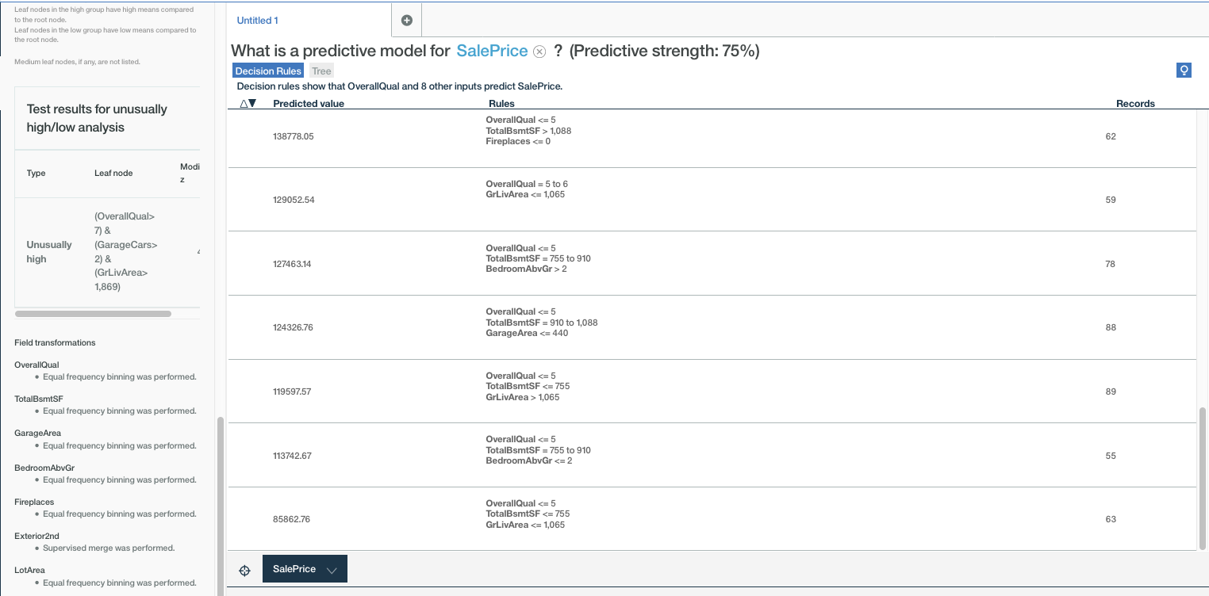
Decision Tree – Showing Predictive model for SalePrice (3/3)

Slide 32
Strategy Overview
Divide the training data set into subset of train and test
(70 percent train and 30 percent test)
Try KNN, Decision tree and random forest , to predict the SalePrice, using train dataset as reference.
Once the SalePrice values are predicted , compare it with the values, present in the test set
Find the accuracy.
Used R- squared as an estimate of accuracy
Depending on accuracy, use the method with highest adjusted R square value, to predict the final SalePrice on testing data set.

Slide 33
Strategy Diagram
2.
test.csv
train.csv
Test Housing data is inputted into KNN model
1.
KNN Model
test.csv
70%
30%
KNN model’s output
to predict SalePrice values
train1.csv
test1.1.csv
Predictive Models Used
Accuracy of Models
KNN Model
SalePrice
86.68%
ORIG SalePrice
73%
.csv file to shows comparison of the accuracy of KNN, Decision Tree, and Random Forest Predictive Models
input
Decision Tree Model
SalePrice
75%
test1.1.csv
Random Forest Model
SalePrice
65%

Slide 34
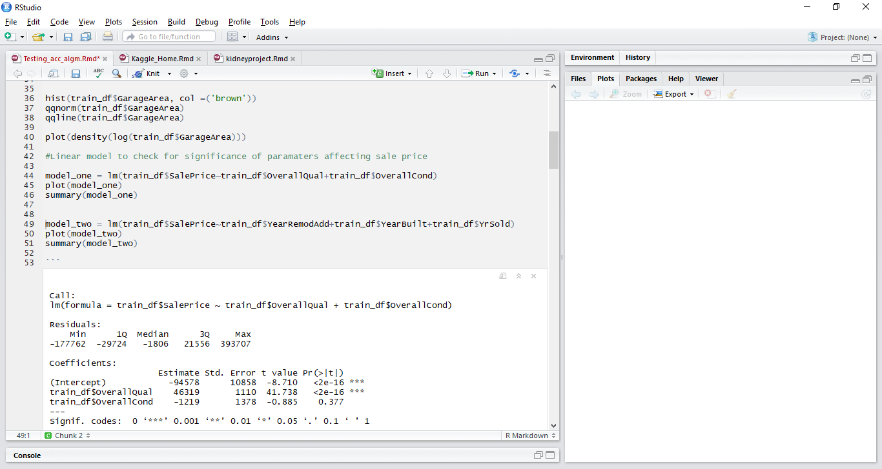
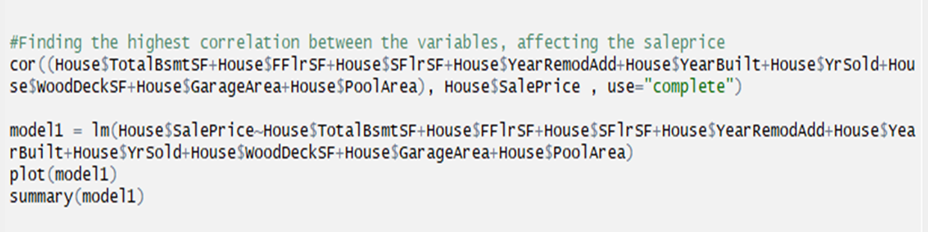
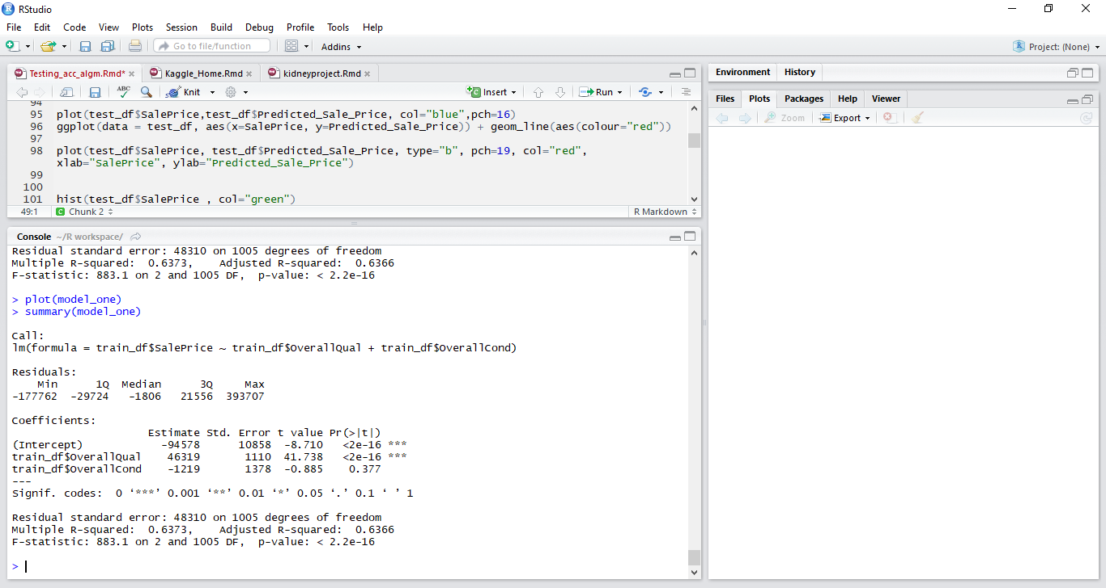
Regression Analysis
Relationship between data points Predictor variables vs response
Finding the variables that are correlated to the sale price
The correlation coefficient between sale price and predictors is 0.83 , which shows a strong relationship

Slide 35
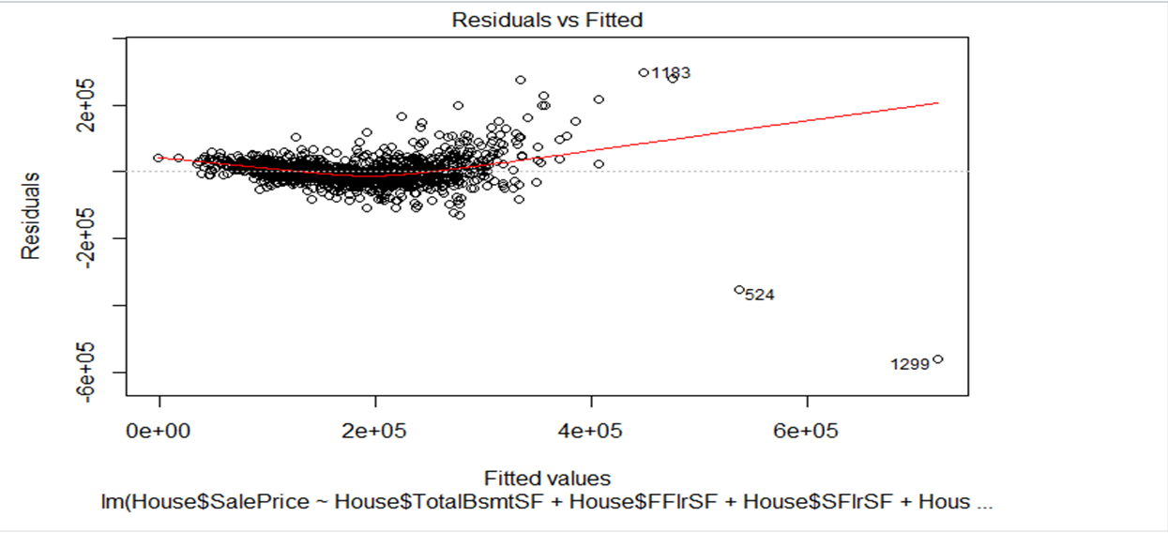
Linear Regression
Linear Regression between response and predictors

Slide 36
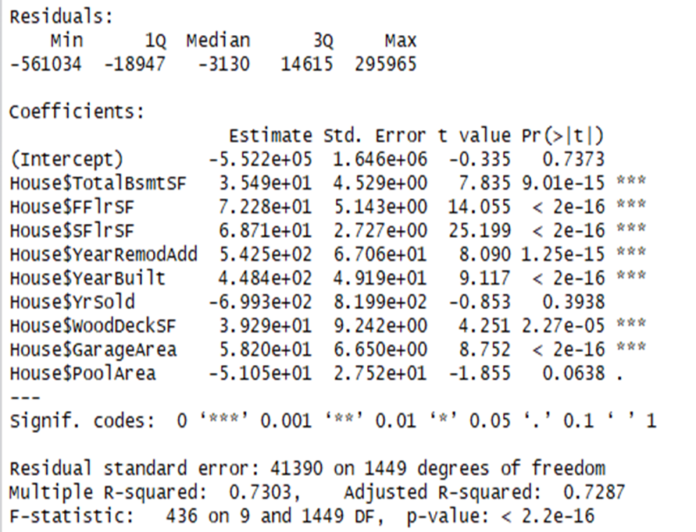
Original Output % of Variance

Slide 37
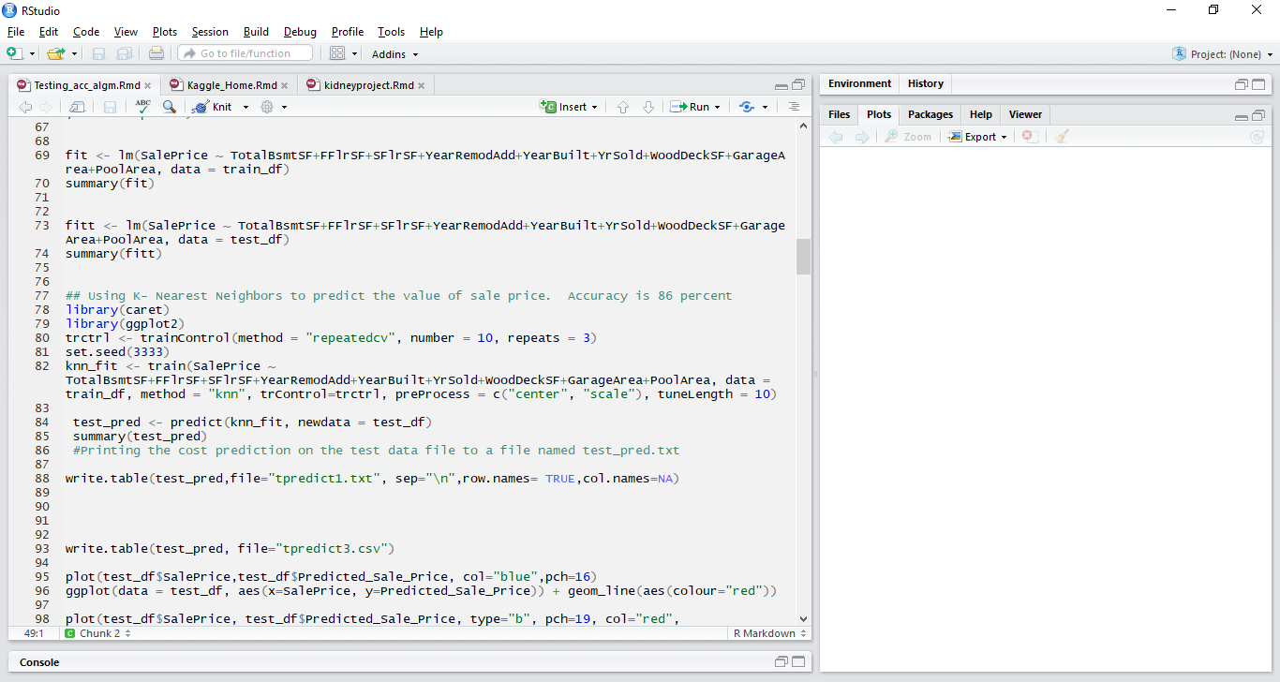
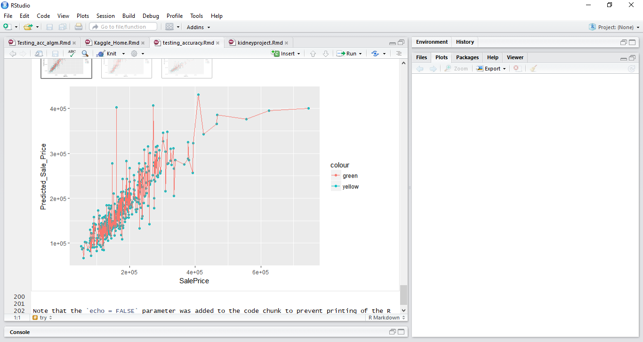
KNN Predictive Modeling
Train control function is of the Caret package
We choose the repeated cross validation
Repeated = 3 , repeating the procedure thrice for
consistency
Default we have used is 10 folds
Predict the value for test based on performance of train
data.
Accuracy is 86 %

Slide 38
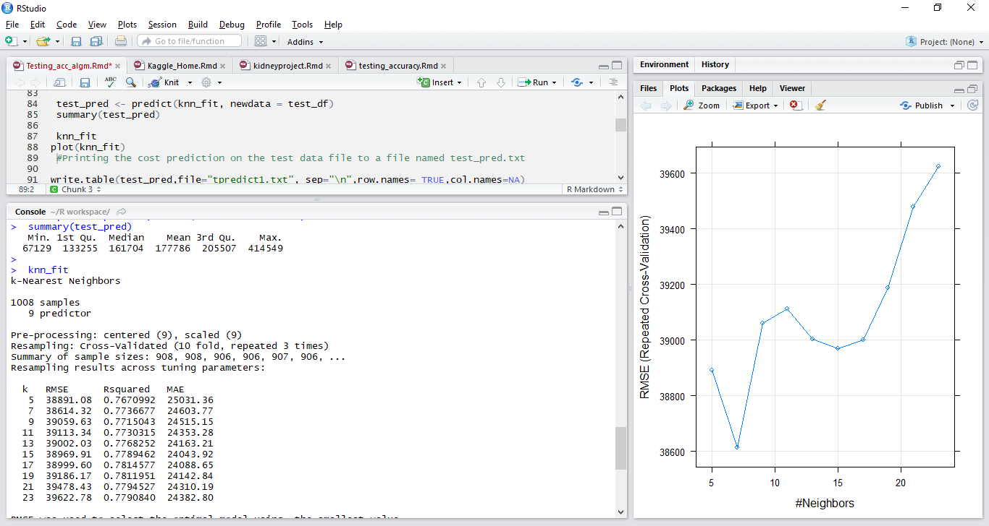
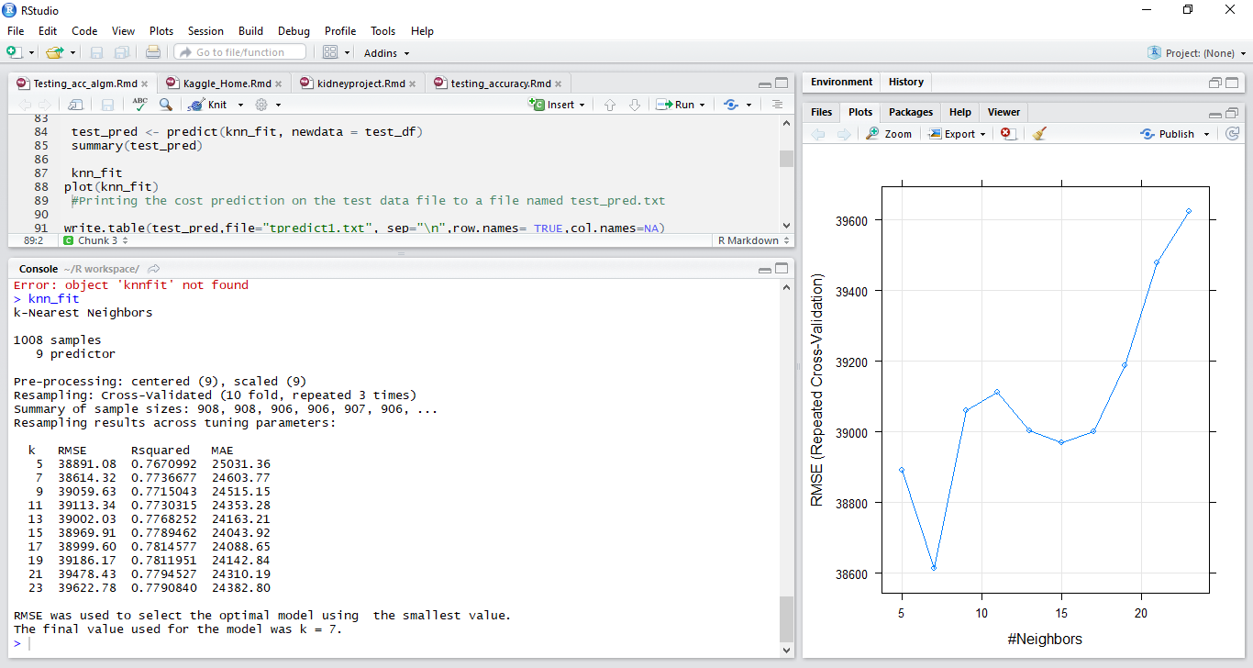
Resampling results across tuning parameters

Slide 39
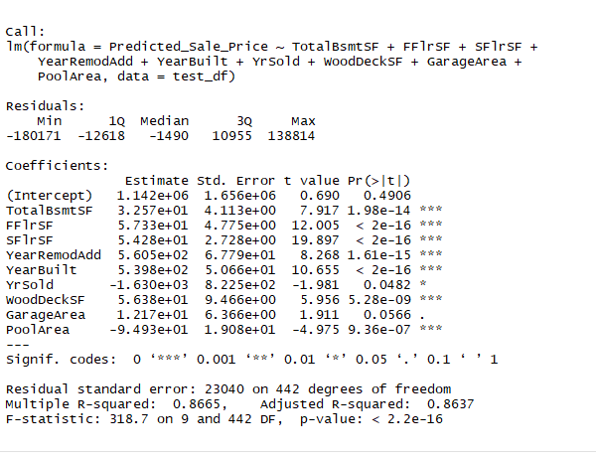
KNN - Output % of Variance

Slide 40
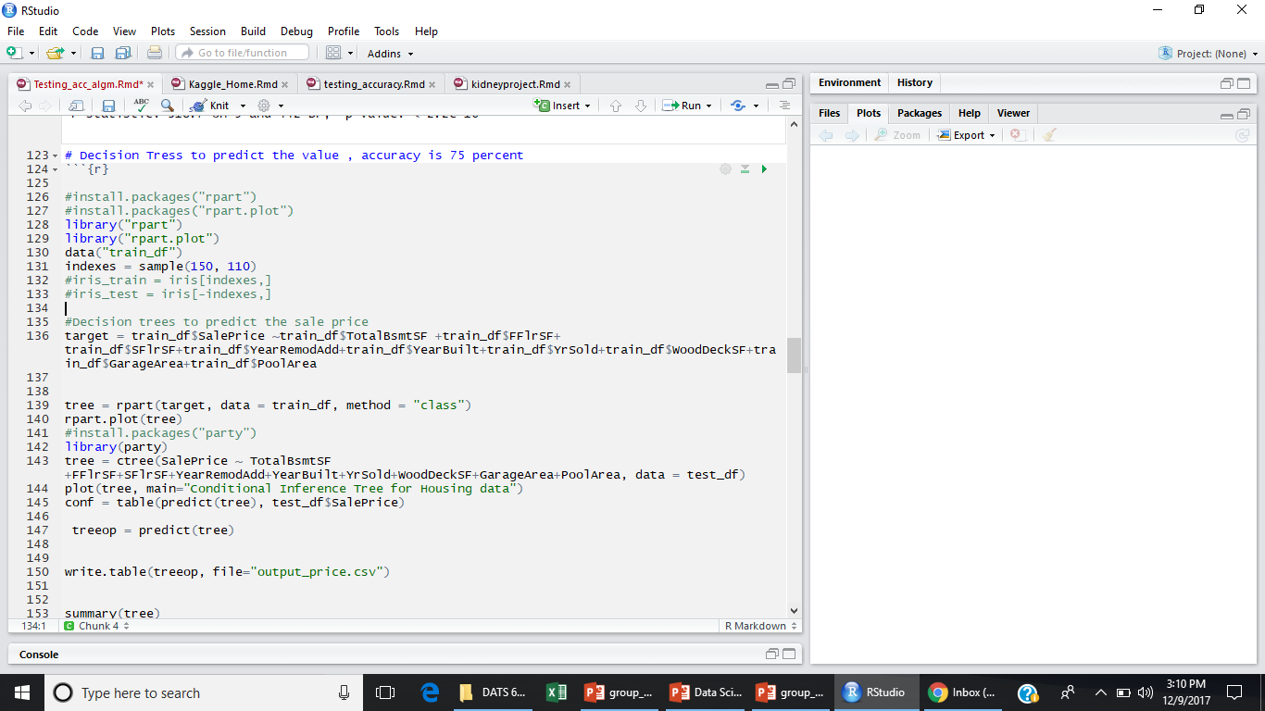
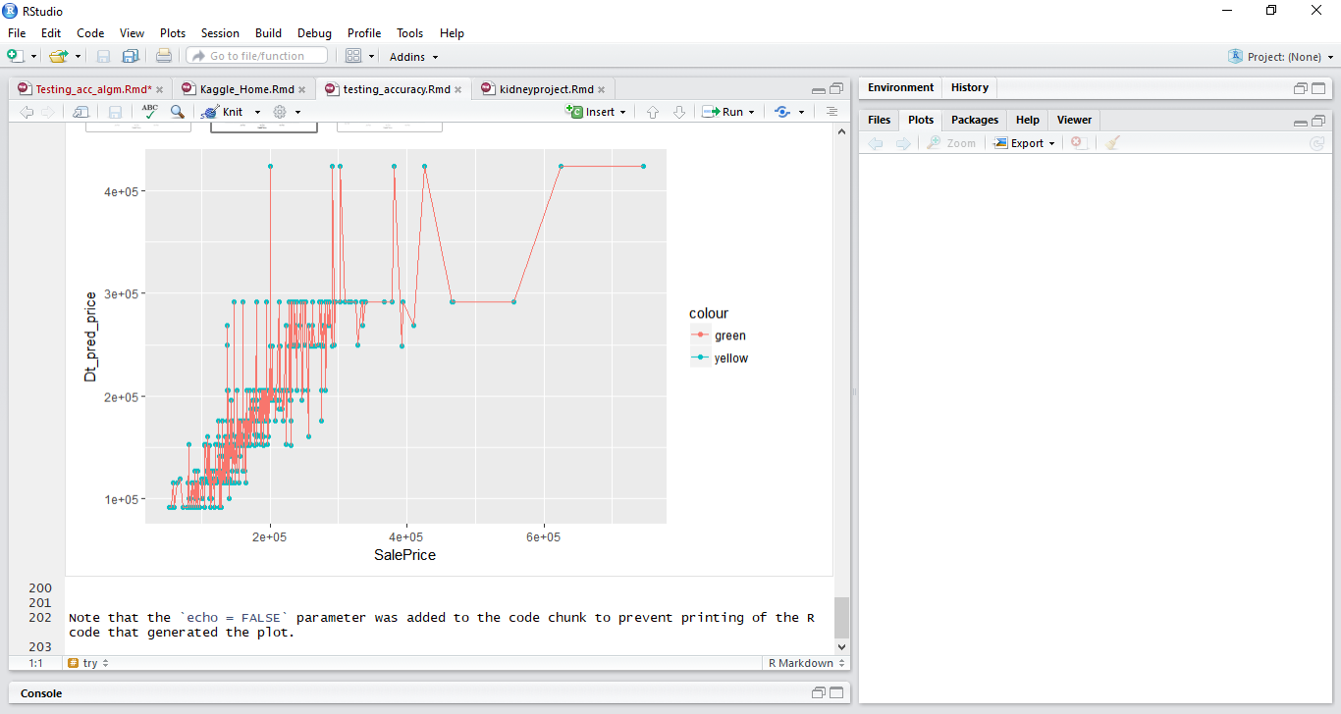
Decision Tree Predictive Modeling
Regression tree is used, cause of the continuous, dependent variable
Load the r part package
Trees divide the predictor space (independent variables) into distinct and non-overlapping regions
Use the rpart function, specifying the model formula, data and parameters
Split is based on the values of cut points.
Accuracy is 75%

Slide 41
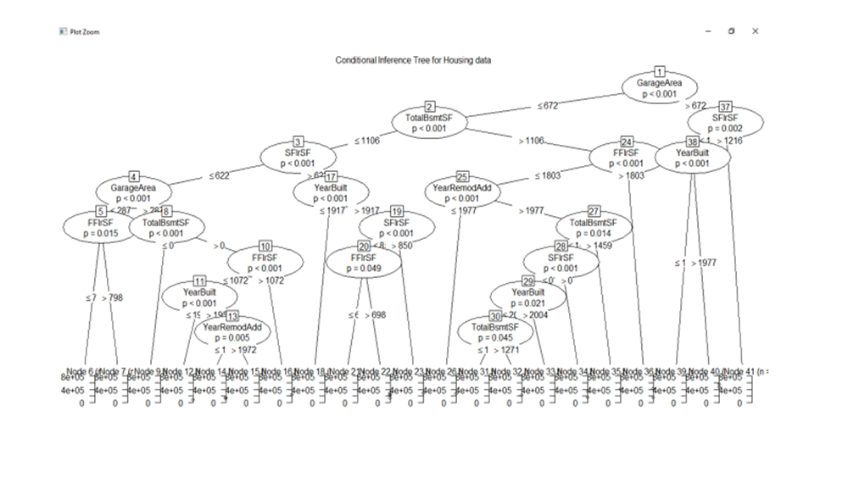
Decision Tree

Slide 42
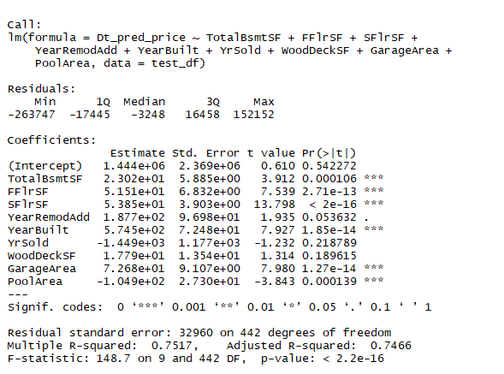
Decision Tree - Output % of Variance

Slide 43
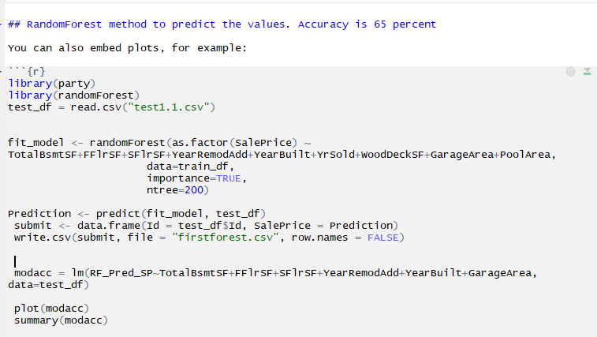
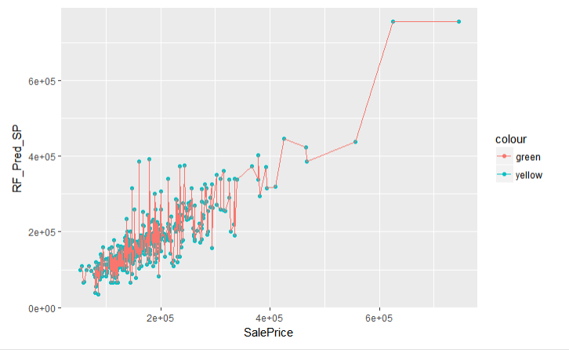
Random Forest Predictive Modeling
The random forest regression is used to predict values
The idea is that real data points that are similar to one another will frequently end up in the same terminal node of a tree
Exactly ,what is measured by the proximity matrix that can be returned using the proximity=TRUE option of randomForest.
Thus the proximity matrix can be taken as a similarity measure
Accuracy is 65%

Slide 44
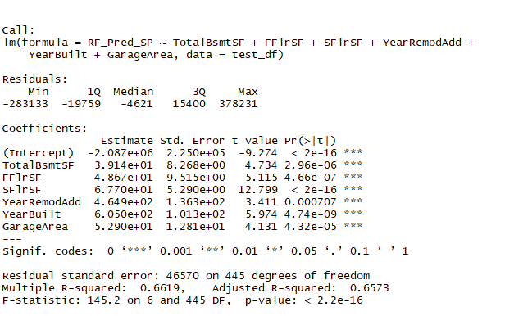
Random Forest – Output % of Variance

Slide 45
Predictive Model Comparison
Dataset | R Squared Value | Adjusted R Squared Value
Train (Original SalePrice) | 77.3 | 77.1
Test (KNN) | 86.65 | 86.37
Test (Decision Tree) | 75.17 | 74.66
Test (Random Forest) | 66.19 | 65.73
KNN’s accuracy was ~9% higher than original SalePrice accuracy
KNN’s accuracy was >10% higher than Decision Tree’s accuracy
KNN’s accuracy was >20% higher than Random Forest’s accuracy
Since KNN Predictive Model had the highest Adjusted R Squared Value and provided an accuracy % that we considered within the range of reasonable, we decided to proceed with the KNN Predictive Model as the method to predict the final SalePrice on the Test data set

Slide 46
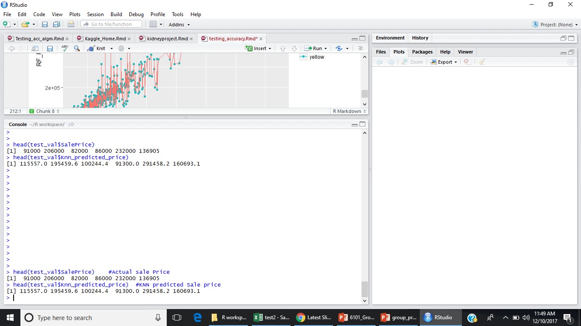
Conclusion – Addressing S.M.A.R.T. Question
If a realtor or home buyer/seller in Ames, Iowa were to ask us if to provide them with predicted home sales prices, based on this research we are confident that we would be able to provide them a predicted Sales Price using a KNN model that would provide them a Sales Price ~86% accurate.
We would also be able to provide them with a predicted min and max Sales Prices. For Example:
Clients provide us with the identified key home-related variables to feed KNN model
We would provide them with a predicted Sales Price (i.e. $265,000) with 86% accuracy
We would also provide predicted min Sales Price ($227,425) and max Sales price ($287,200)

Slide 47
Conclusion
We, could effectively predict the sales price of the houses, given the train and test data set
With the help of variables, that had the highest significance in relation to the Sale Price.
The train set had adjusted R square of 72 percent , using sale price as response variable and the same combination of predictors
Out of all the methods employed to predict the sale price, KNN outperformed the rest like decision trees and random forest, yielding an adjusted R squared rate of 86 %, even higher than the train data.

Slide 48
Background/Reference Slides

Slide 49
References
The train and test data set is retrieved from https://www.kaggle.com/c/house-prices-advanced-regression-techniques/data.

